Slide 1

REAL TIME WEB BASED AUCTION AND BIDDING SYSTEM
CAPSTONE PROJECT PRESENTATION
CSA4305 – Internet Programming
Supervised By:
Dr. SUDHAGAR D
Presented by:
192411091 - POOJASREE B
192471035 - AMRITA ANAIKUMAR
192471048 - VENNA MEENAKSHI REDDY
192471024 - SRIJITHA S
192311363 - MATHUSRI P

Slide 2



ABSTRACT
A web-based platform that enables users to buy and sell products through online auctions.
Provides secure user registration, authentication, and profile management.
Allows sellers to create, update, and manage auction listings. Supports real-time bidding with automatic highest bid tracking.
Integrates secure payment processing and transaction management.
Includes an admin module for monitoring users, auctions, and generating reports.

Slide 3

INTRODUCTION
Online auctions have transformed traditional buying and selling methods.
Enables buyers and sellers to participate from anywhere through the internet.
Eliminates geographical limitations of physical auctions.
Provides transparency through real-time bidding.
Ensures secure transactions and fair winner selection.
Designed for ease of use with an interactive and responsive interface.

Slide 4
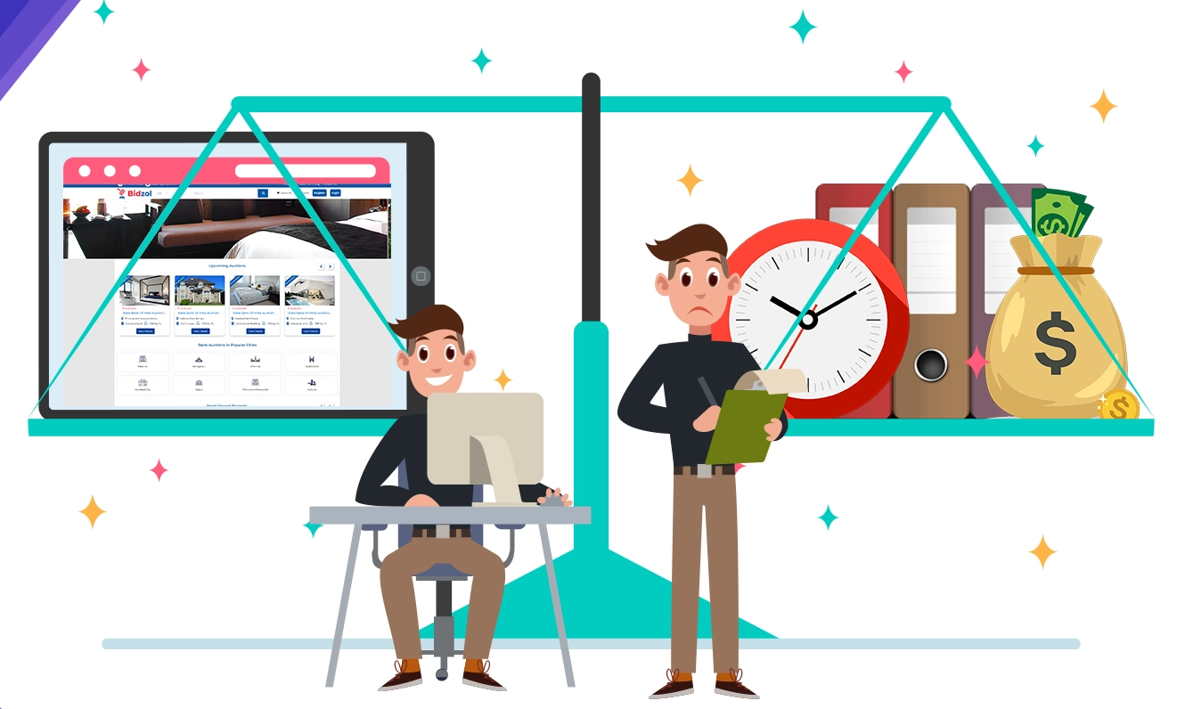
PROBLEM STATEMENT
Traditional auctions require physical presence and are time-consuming.
Manual bidding processes are prone to errors and lack transparency.
Difficulty in tracking bids and determining the highest bidder efficiently.
Limited accessibility for buyers and sellers from different locations.
Security concerns in user authentication and payment processing.
Lack of centralized management for auction records and reports.

Slide 5
OBJECTIVES
To develop a secure and user-friendly online auction platform.
To provide secure user registration, login, and profile management.
To enable sellers to add, update, and manage products for auction.
To provide administrators with tools to manage users, auctions, and system activities.
To generate reports for monitoring auction and transaction activities.

Slide 6
LITERATURE REVIEW
Authors | Year | Title / Focus | Technology Used | Gap / Relevance to Your Project
Saif, E. R. A. | 2026 | A Modular Object-Oriented Online Bidding System for Efficient Electronic Auction Management | C++, Object-Oriented Programming | Standalone desktop app only; no web-based real-time multi-user bidding, database storage, or secure payment integration.
Vaishnavi K., Santhiya S., Ashvitha S., Anusha D. | 2026 | Dual-Mode Blockchain Based Auction System for Secure and Anonymous Bidding | Blockchain, zk-SNARKs, Ring Signatures | Focuses on cryptographic anonymity and security; lacks integrated admin reporting and a full e-commerce workflow.
Murugan J. et al. | 2024 | Empowering Farmers: A Real-Time Bidding System with Integrated Machine Learning | Machine Learning, Real-Time Bidding | Domain-specific to agriculture; lacks a generalized multi-role platform with payment and admin management.
Goyal H., Kundnani M., Singh M.K., Gupta N. | 2023 | Analysis, Design and Implementation of a Web-Based Online Auction System | Web Application (HTML, PHP/MERN) | Limited focus on scalability, security, and structured admin reporting for large-scale auctions.

Slide 7
SUSTAINABLE DEVELOPMENT GOALS (SDGS)
SDG 8 – Decent Work and Economic Growth
Supports online buying and selling opportunities.
Helps sellers reach more customers through a digital marketplace.
Promotes efficient and accessible commercial activities.
SDG 9 – Industry, Innovation and Infrastructure
Uses web technologies to modernize the traditional auction process.
Provides real-time bidding and digital transaction management.
Encourages technological innovation in e-commerce.
SDG 12 – Responsible Consumption and Production
Provides a platform for reselling and purchasing existing products.
Can support reuse of products instead of unnecessary new production.
Helps connect sellers and buyers efficiently.
SDG 16 – Peace, Justice and Strong Institutions
Promotes transparency through real-time bidding and maintained bidding history.
Secure authentication and transaction records improve trust.
Admin monitoring helps ensure fair and reliable auction activities.

Slide 8
EXISTING SYSTEM &PROPOSED SYSTEM
Existing System
Proposed System
• Traditional auction system and existing online auction platforms are available. • Sellers list products for auction. • Buyers place bids on products. • Highest bidder wins the auction. • Payment is completed after winning. • Some systems are complex and have service charges.
• Real-time bidding delivers instant live updates. • Automated system rejects invalid or duplicate bids. • Optimized database enables faster search results. • Role-based access control for all user types. • Instant alerts for bids, closure, and payments. • Admin dashboard offers analytics-based reporting.

Slide 9
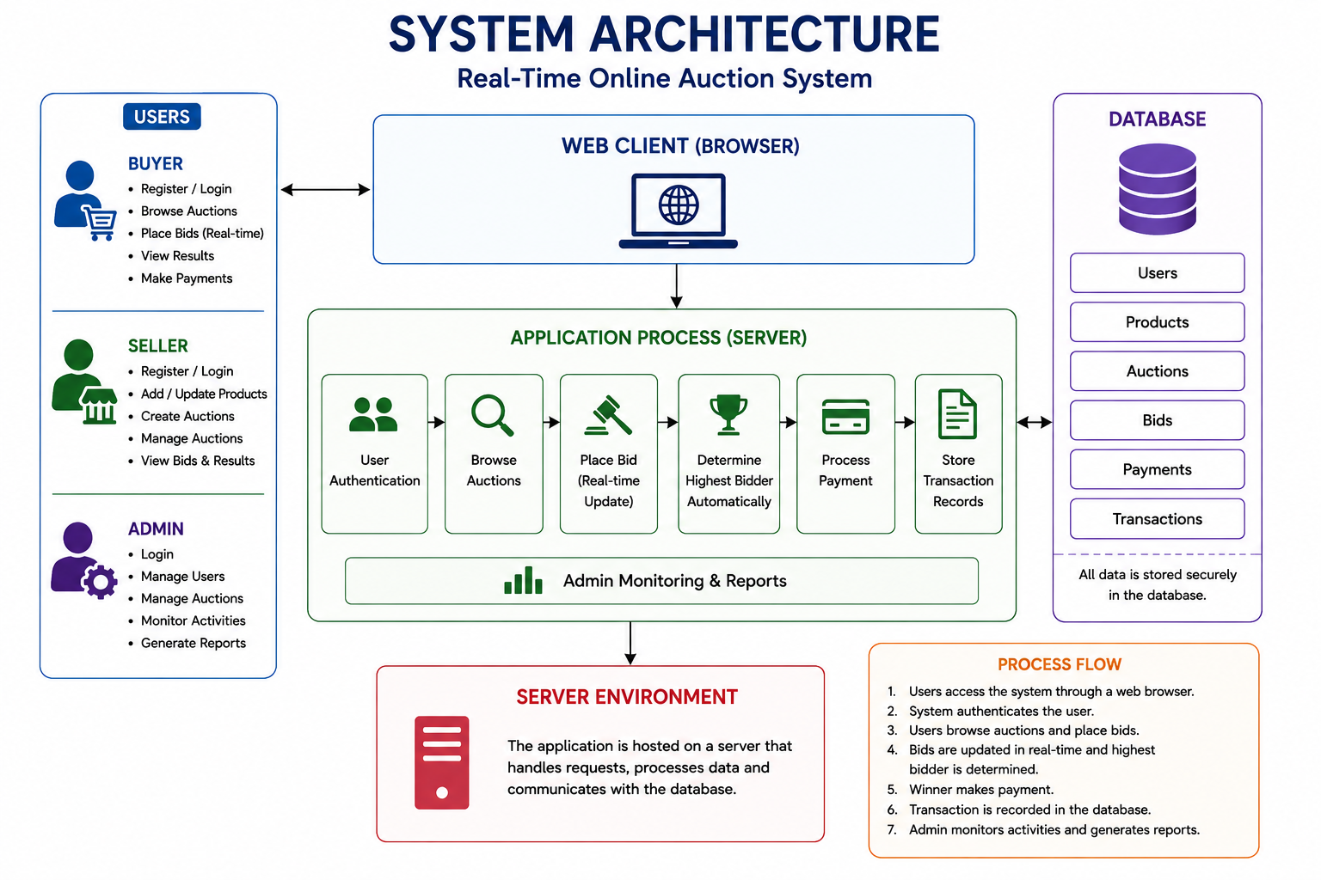
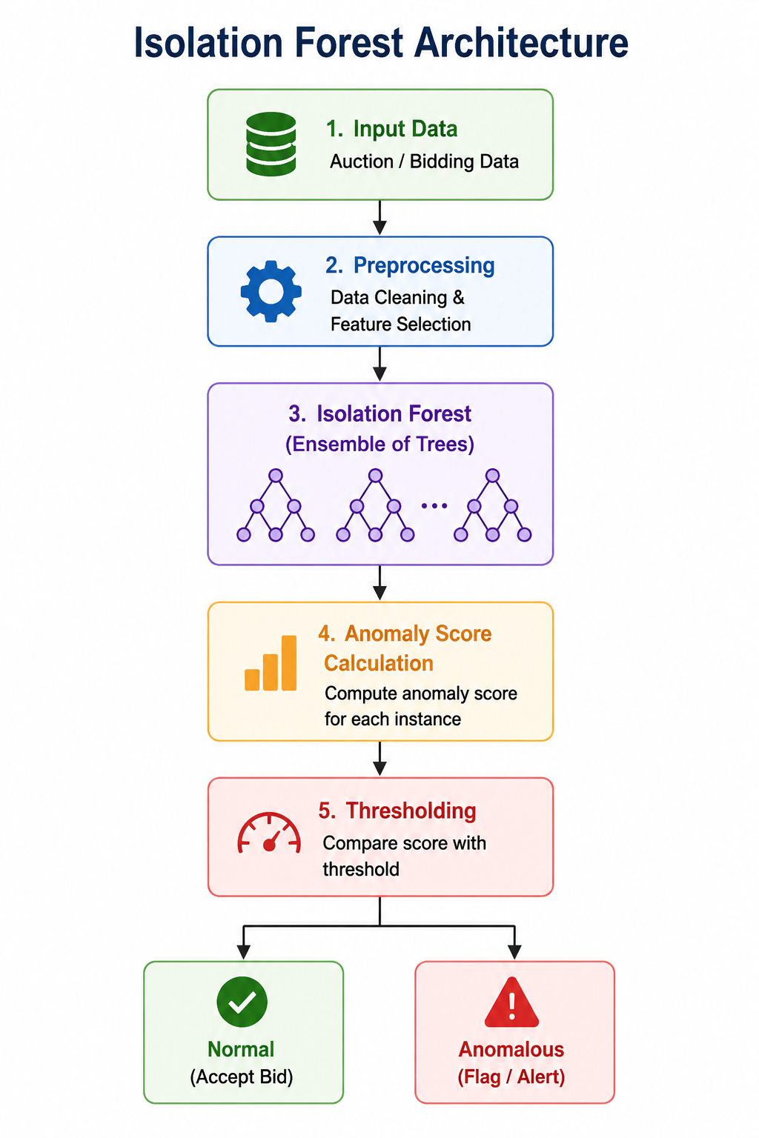
SYSTEM ARCHITECTURE
DATASET USED – UCI Shill Bidding Dataset

Slide 10

MODULE 1
USER MANAGEMENT MODULE
The system allows users to securely register and log in to the auction platform.
The system provides separate access and functionalities for buyers, sellers, and administrators.
Users can update their personal information and account credentials.
The system manages user authentication and authorization.
Administrators can monitor, manage, and control registered user accounts.

Slide 11
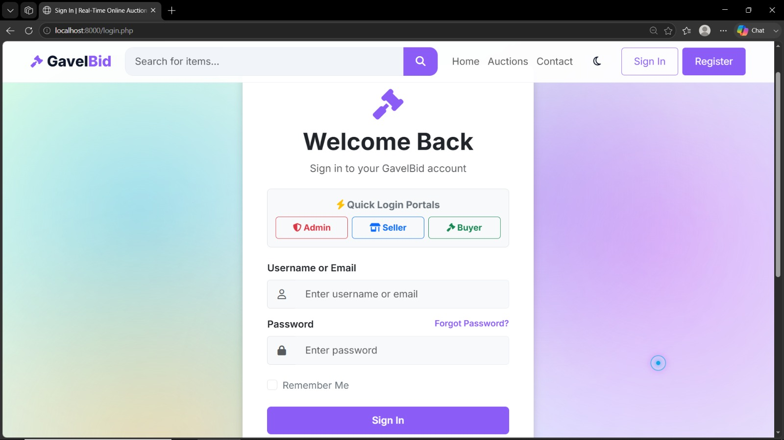
OUTPUT

Slide 12

MODULE 2 PRODUCT MANAGEMENT MODULE
Sellers can add products to the platform with relevant product details.
Sellers can provide the product name, description, image, starting price, and other required information.
Sellers can update or modify product information whenever required.
Buyers can view and search for products available for auction.
All product information is securely stored and managed in the database.

Slide 13
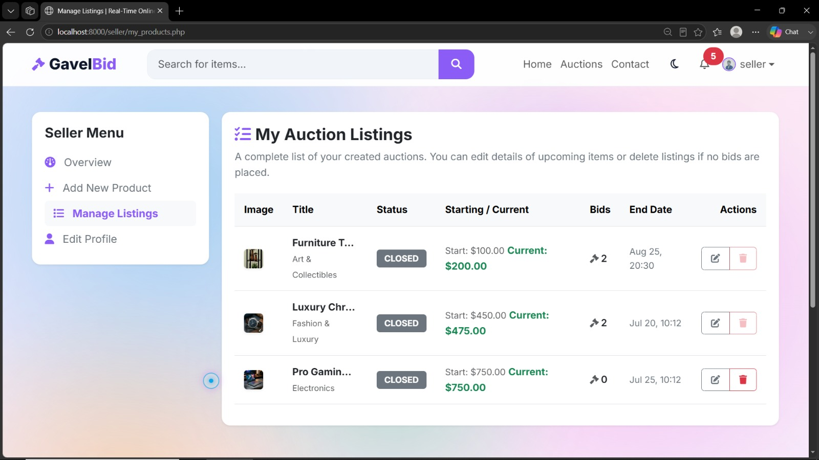
OUTPUT​
​

Slide 14

MODULE 3 AUCTION & BIDDING MODULE
Sellers can create auctions by specifying the starting price and auction duration.
Buyers can browse available auctions and view detailed product information.
Buyers can place bids on products during the active auction period.
The system validates each bid and automatically updates the highest bid.
The system identifies the highest bidder when the auction period ends.
Auction results and complete bidding history are maintained for transparency

Slide 15
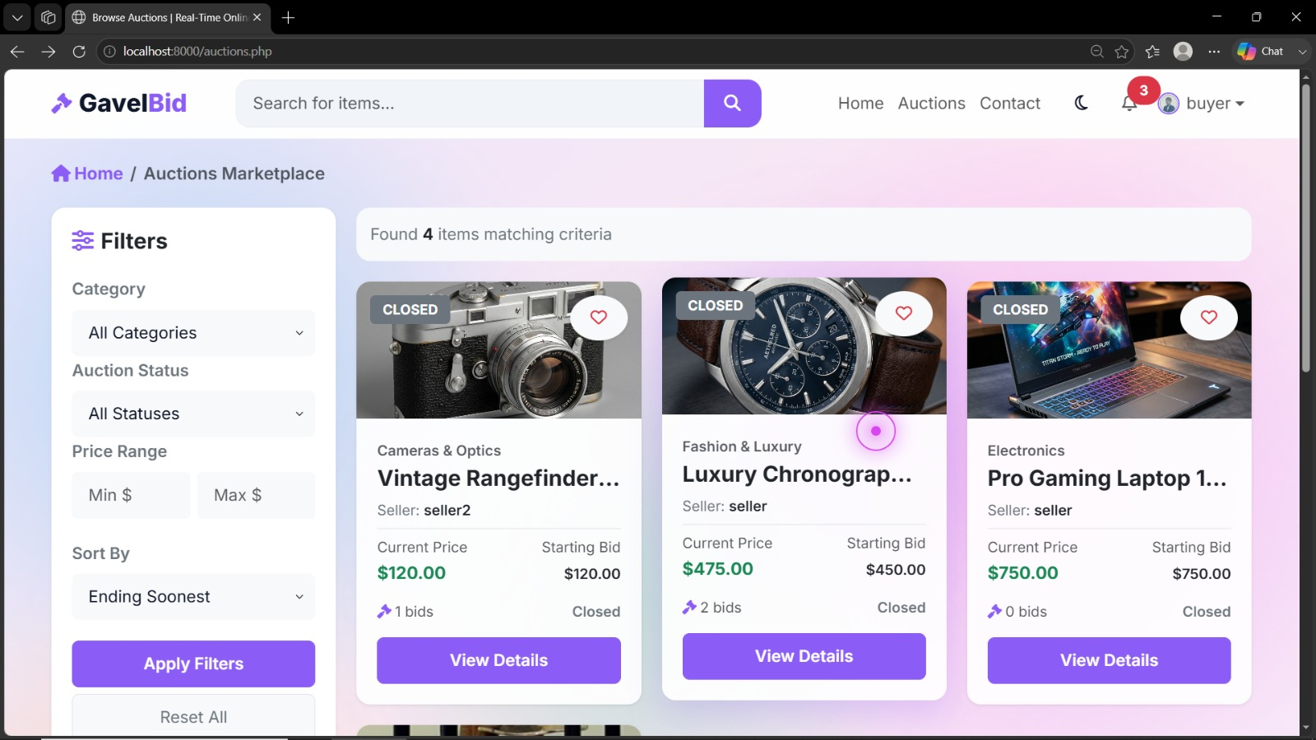
OUTPUT​
​

Slide 16

MODULE 4 PAYMENT & TRANSACTION MODULE
The system allows the winning bidder to proceed with the payment after the auction ends.
Payment details are recorded and associated with the corresponding auction.
Buyers can view their payment and transaction history.
Sellers can view the transaction details related to their sold products.
Administrators can monitor and manage payment and transaction records.

Slide 17
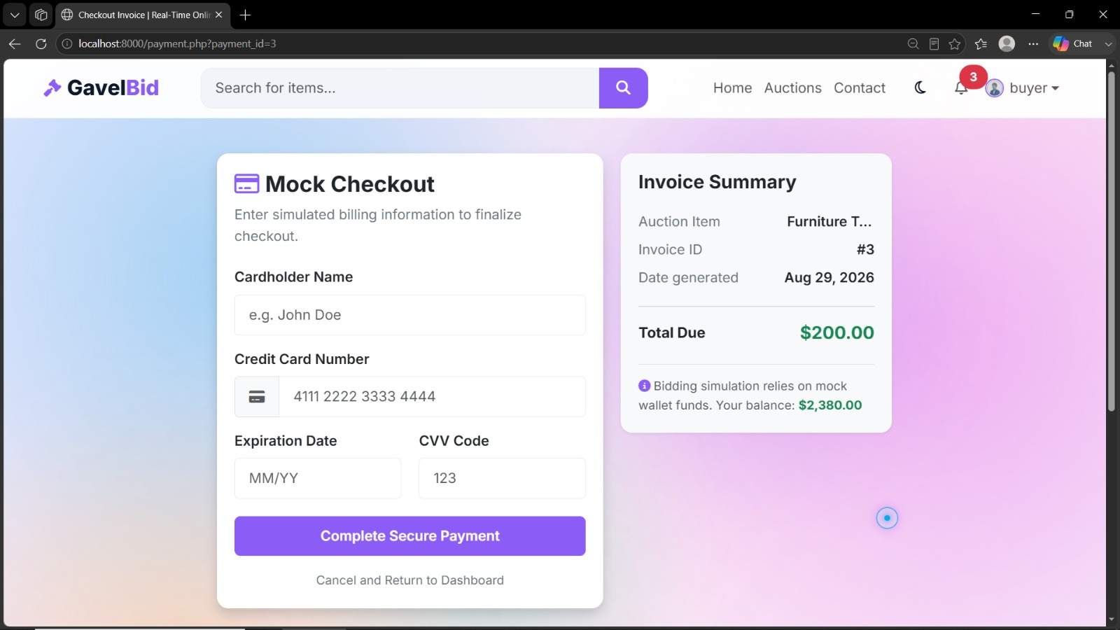
OUTPUT​
​

Slide 18

MODULE 5
ADMIN & REPORTS MODULE
The administrator can manage and monitor registered users on the platform.
The administrator can monitor products and active or completed auctions.
The administrator can monitor bidding activities and auction results.
The administrator can manage payment and transaction records.
The system generates reports related to users, products, auctions, and transactions.
The administrator can monitor overall system activities to ensure efficient operation.

Slide 19
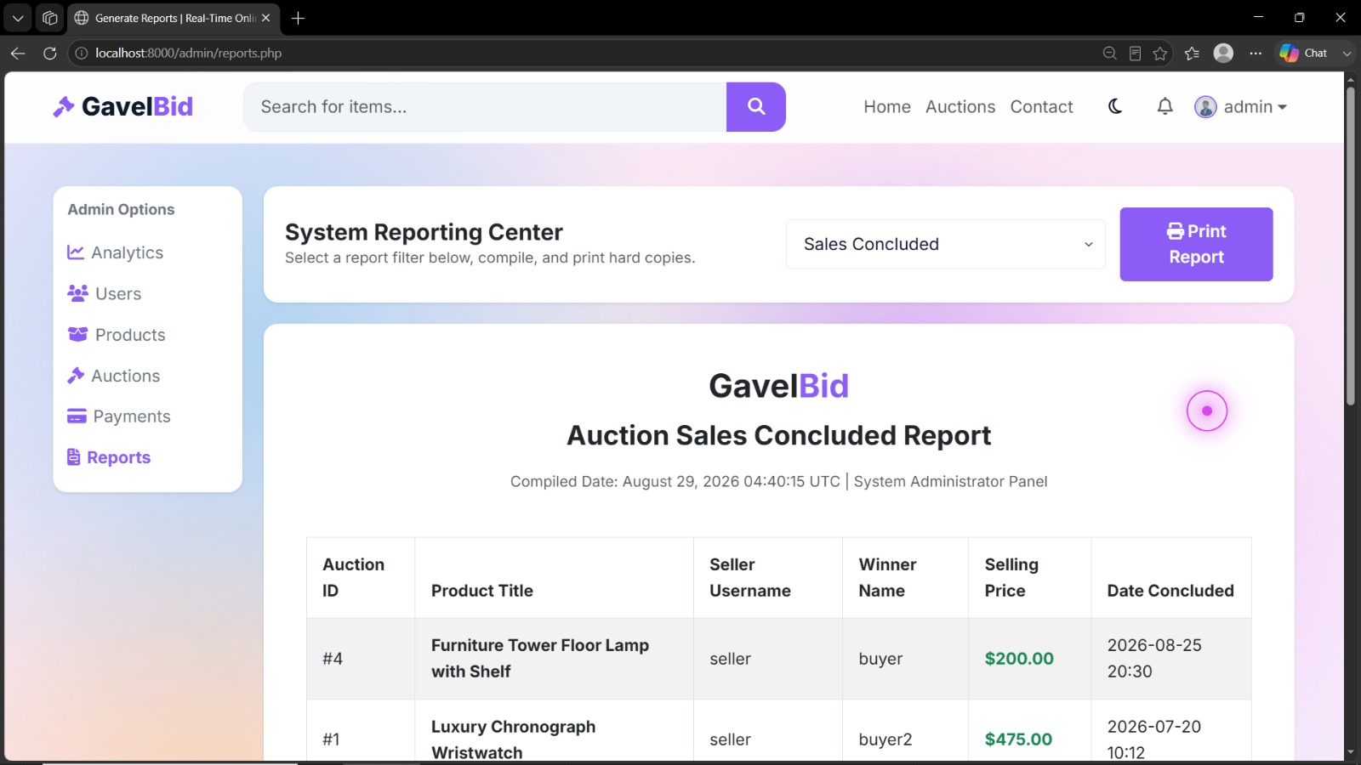
OUTPUT​
​

Slide 20
RESULTS AND DISCUSSION
The system successfully supports user registration, login, authentication, and profile management.
Sellers can add, update, delete, and manage products available for auction.
Buyers can participate in auctions, place bids, and view the current highest bid.
The system identifies the highest bidder when the auction ends, ensuring a fair selection process.
Winning bidders can complete payments, while transaction details are securely recorded.
Administrators can monitor users, products, auctions, and transactions and generate relevant reports.

Slide 21
SOFTWARE REQUIREMENTS
Operating System: Windows, Linux, or macOS
Frontend: React.js, HTML, CSS, JavaScript
Backend: Spring Boot (Java) or Node.js
Database: MySQL
AI Framework: Python, TensorFlow or Scikit-learn
IDE: VS Code, IntelliJ IDEA, or Eclipse
Browser: Google Chrome, Microsoft Edge, or Firefox

Slide 22

FUTURE SCOPE
AI-based product recommendations based on user interests and bidding history.
Real-time bid updates using WebSockets.
Secure online payment gateway integration.
Mobile application for anytime, anywhere auction access.
Automated notifications for bids, auction results, and payments.
Advanced security and fraud detection for improved reliability.

Slide 23
CONCLUSION
The Real-Time Web Based Auction and Bidding System provides a secure and user-friendly platform for conducting online auctions.
The system automatically tracks the highest bid and selects the winner when the auction ends.
Payment and transaction details are maintained for accurate record keeping.
The admin can manage users, auctions, transactions, and generate reports.
The proposed system improves transparency, accessibility, efficiency, and reliability in the online auction process.

Slide 24
REFERENCES
[1] C. Chikkudu, S. Srinaramdas, A. Nagesh, and S. Kambli, “Web Bidding Platform,” Advanced Innovations in Computer Programming Languages, vol. 7, no. 3, pp. 64–70, 2025. �
Zenodo
[2] H. Ekhande, P. Biradar, A. Lahane, M. Singh, and N. Shivale, “Online Auction System,” International Journal of Advance Research, Ideas and Innovations in Technology, vol. 10, no. 1, 2024. �
IJARIIT
[3] S. P. Gunjal, A. Birajdar, A. Phalke, N. Raskar, and T. Gouri, “E-Auction—A Web Based Electronic Auctioning System,” International Journal for Research in Applied Science & Engineering Technology, 2024.
[4] V. Naveenkumar, S. Abirami, K. Dharshini, E. Girija, and J. Hemalini, “Online Auction System Using PHP and MySQL,” International Journal of Engineering Research and Modern Education, vol. 7, no. 1, pp. 22–27, 2022. �
Zenodo
[5] I. A. Omar, H. R. Hasan, R. Jayaraman, K. Salah, and M. Omar, “Implementing Decentralized Auctions Using Blockchain Smart Contracts,” Technological Forecasting and Social Change, 2021.

Slide 25
THANK YOU!!

